Slide 1
Oregon Tax Update
Christopher Ishihara
Stoel Rives
Christopher.Ishihara@stoel.com

Slide 2

2025 Regular Session

Slide 3
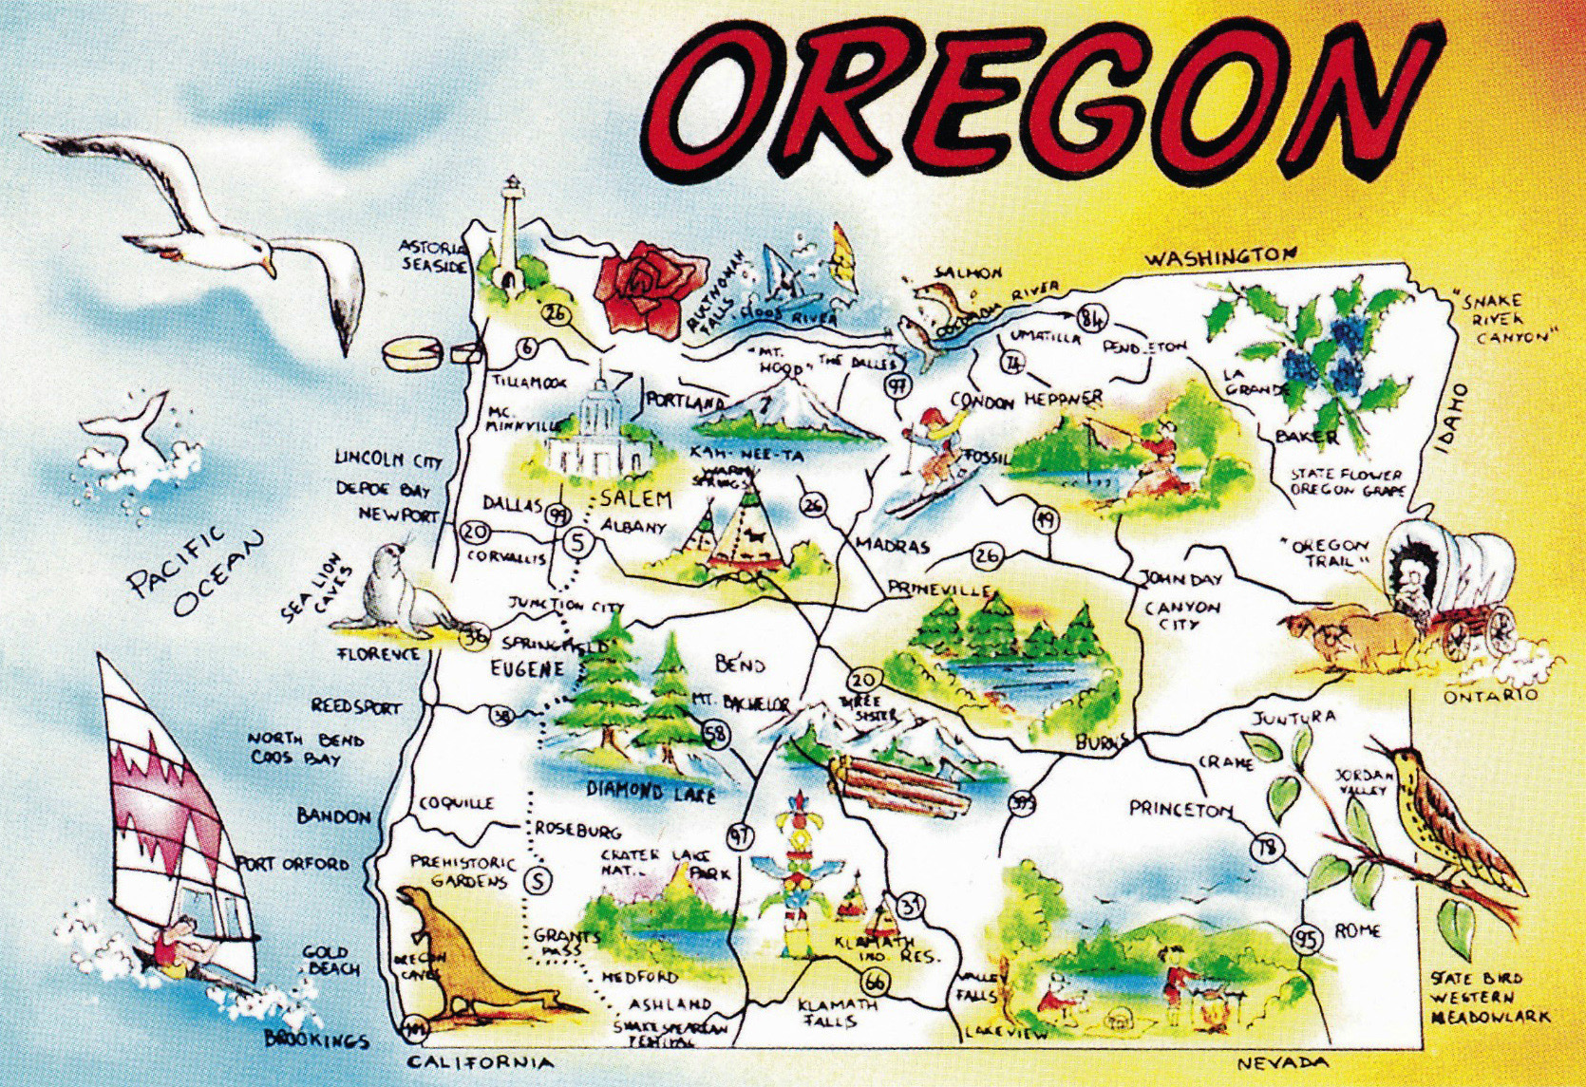
State Taxes

Slide 4
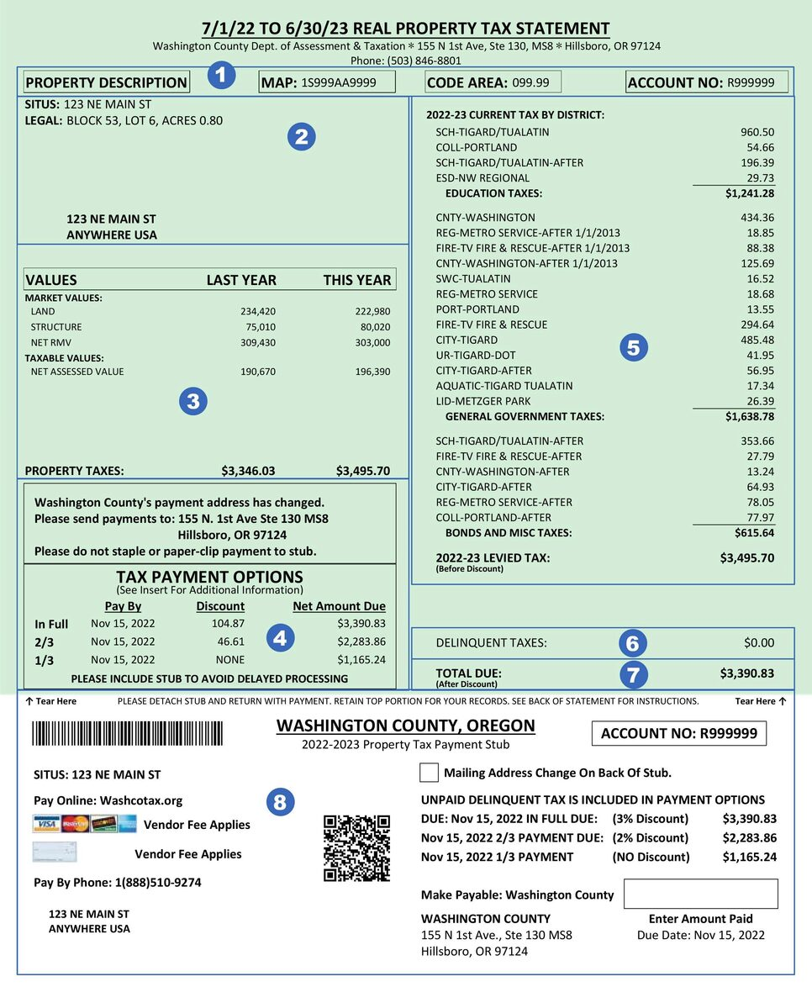
Property Taxes

Slide 5
Property Tax Legislation
Property Tax Exemption Extenders:
Oregon Laws 2025, chapter 191 (HB 2074): Mixed use projects in a vertical housing development zone.
Oregon Laws 2025, chapter 192 (HB 2077): Low-income housing owned by a nonprofit corporation.
Oregon Laws 2025, chapter 193 (HB 2078): Newly constructed or rehabilitated multi-unit housing.
Historic Property Special Assessment is now limited to commercial property. Oregon Laws 2025, chapter 209 (HB 3190).
Homestead Property Tax Deferral Program. Oregon Laws 2025, chapter 449 (HB 3712):
Household income limit increased to $70,000.
Real Market Value limit increased to 150% of county median RMV.

Slide 6
Property Tax Cases
Delta Air Lines, Inc. v. Dept. of Rev., 374 Or 58 (2025) – Delta argued that it is unconstitutional to tax the intangible property of centrally assessed taxpayers, but not to tax the intangible property of all other taxpayers. The Oregon Supreme Court concluded only taxing intangible property of centrally assessed taxpayers is rationally related to the legitimate government purpose of obtaining revenue, and therefore constitutional.
PacifiCorp v. Dept. of Rev., 374 Or 189 (2025) – The Oregon Supreme Court considered the narrow question of whether the Oregon Tax Court must defer to the Department of Revenue’s administrative rule incorporating the Western States Association of Tax Administrators (WSATA) Appraisal Handbook. The Oregon Supreme Court concluded that the Oregon Tax Court must treat the department’s rule as law, but does not preclude a taxpayer from arguing that the WSATA Handbook as applied to the taxpayer produces an outcome contrary to the constitution or statute.

Slide 7
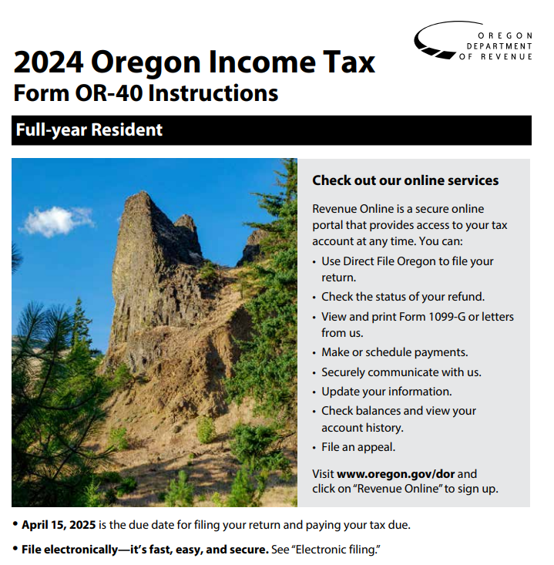
Income & Excise Taxes
Personal Income Tax
Corporation Excise Tax
Corporation Income Tax
Corporate Activity Tax

Slide 8
Income Tax Extenders
Earned income tax credit (ORS 315.266) extended to December 31, 2031.
The crop donation tax credit (ORS 315.156) extended to December 31, 2031.
Mobile home closure credit (ORS 316.090) extended to December 31, 2031
Corporation Excise Tax credit (ORS 317.097) expanded to lenders making mortgage loans to first-time homebuyers.
Tax credit for rural emergency medical services providers (ORS 315.622) increased to $1,000 and extended to December 31, 2029.
First time homebuyer savings account subtraction (ORS 316.798) extended to accounts opened by December 31, 2031. Oregon Laws 2025, chapter 562 (HB 2087).
Film production credit (ORS 315.514) increased to $20.6 million for fiscal year 2025-26, and $21.2 million in subsequent years.

Slide 9
Income Tax Cases
Microsoft Corp. v. Dept. of Rev., TC 5413 (April 29, 2025) – TCJA deemed repatriated foreign income subpart F income. The Tax Court concluded that the repatriated amount should be included in the Oregon sales factor because the controlled foreign corporations and the parent were all engaged in a single unitary business (selling Microsoft software in the U.S. and abroad).
Chevron U.S.A. Inc. v. Dept. of Rev., TC 5461 (July 21, 2025) – Chevron wanted to include gross receipts from hedging transactions (oil and gas futures, options, and swap contracts) in its Oregon sales factor. The Tax Court concluded that the receipts from hedging transactions were should not be included in the Oregon sales factor because the gross receipts were separate from Chevron’s primary business activity.

Slide 10

Income Tax-Related
Professional Employer Organization (PEO) may treat employees as employees of PEO or of the client employer for unemployment insurance purposes. Oregon Laws 2025, chapter 280 (HB 2236).
Registered Tax Aides are a new tax professional certification, who will assist a tax consultant in the preparation of tax returns, but only under the supervision of a tax consultant. Oregon Laws 2025, chapter 347 (HB 2338).

Slide 11
Oregon Tax Court
Oregon Laws 2025, chapter 250 (HB 2119)
Allows an association or organization to seek declaratory relief in the tax court if:
Member(s) of association or organization is adversely affected or aggrieved by subject of requested declaration;
Interests sought to protect germane to purpose; and
Nature of claim does not require that member(s) adversely affected or aggrieved participate

Slide 12
Employment & Estate Tax Legislation
Employment Tax:
Unpaid Wages in Construction Contracts. Owner and direct contractor in construction contract are jointly and severally liable for unpaid wages to any unrepresented employees of the direct contractor or a subcontractor. Oregon Laws 2025, chapter 287 (SB 426).
Estate Tax:
Natural Resource Exemption expanded to include interests owned by a trust or business entity. Also allows for 1031 like-kind exchanges. Oregon Laws 2025, chapter 577 (HB 3630).
Small amounts of forestland (at least 10 acres, but not more than 5,000 acres) are now exempt from the Oregon estate tax, if certain requirements met. Oregon Laws 2025, chapter 595 (SB 485).
Simple Estates allow streamlined option for estates with total value under $275,000 ($75,000 personal property + $200,000 real property). Rules changed to include value of manufactured homes under “real property” instead of personal property. Oregon Laws 2025, chapter 342 (SB 15).
Initiative Petition 51

Slide 13

Portland Area Income Taxes
Multnomah County Preschool for All Personal Income Tax
Metro Supportive Housing Services Personal Income Tax
Portland Business License Tax
Multnomah County Business Income Tax
Metro Supportive Housing Services Business Income Tax

Slide 14

Developments in Local Income Taxes
Substantively:
Three cases have challenged the Metro Supportive Housing Services or Multnomah County Income Tax. Discussions regarding many more.
Administratively:
What’s going on within the Portland Revenue Bureau is increasingly important.

